Slide 1
Run Time Environment

Slide 2
Execution of program
Translation of program.
Linking of one prog with another progs. Needed for its execution
Relocation of the program to execute form the specific memory area location
Loading of the program in memory to perform execution
Step 1 is perform by translator
Steps 2 & 3 are performed by linker
step 4 is performed by loader

Slide 3
Introduction:
Source program
Translator
Translator translates source program to machine code and creates object file.
Linker receives set of object files and links them solving external reference problems and creates ready to execute file.(which is a binary file).
Loader loads this binary file to execution area for its execution
.Obj
Linker
.exe
Loader
Program execution

Slide 4
Some terminology used to refer to programing address
Translation time address :address assign by translator
Linked address : address assign by linker
Load time address: address assign by loader

Slide 5
Same terminology as assigning the origin of program
Translated origin : Address of origin assumed by the translator.
This address is specified by ORIGIN.
Linked address: Address of origin assign by the linker while generating binary program
Load origin : Address of origin assign by the loader while loading program for execution.

Slide 6
Important terminologies :
Lang. Processors-> | Translator | Linker | Loader
Types of address
Start/Origin | Translator_Orgin ( t_origin) | Linker_Orgin ( l_origin) | Loader_Origin (ld_origin)
Symbol Address | Translated address/Translator time address (tsymb) | Link address / Link time address (lsymb) | Load address/Load time address (ldsymb)

Slide 7
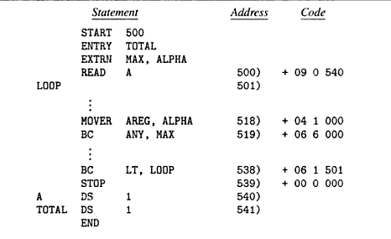
Assembly language program and its generated code

Slide 8
Relocation and linking Concepts
Let AA be set of absolute addresses used in the program P.
If AA!= Φ implies that program P assumes that instructions and data occupy specific addresses. a such program is called address sensitive program.
Address sensitive programs can execute correctly only if start address is same as translated origin. To execute correctly , addresses must be corrected.

Slide 9
Program relocation
It is the process of modifying the addresses used in asi of a program such that the program can execute correctly from the designated area of memory
Relocation can be done by the linker or loader
If linked origin != translated origin then relocation is done by linker
If load origin!= linked origin then relocation is done by loader
In general linker performs relocation.

Slide 10
Relocation factor=l_originp - t_origin (1)
If statement uses symbol as an operand,then
tsymb=t_origin+dsymb
dsymb is the offset of a program
For link symbol
Lsymb = l_origin+dsymb

Slide 11
Lsymb=t_origin +relocation factor+dsymb
=t_orgin +dsymb+relocation factor
=tsymb+relocation factor
IRR=Instructions requiring relocation.
Ex: Let IRR for prog P has dispalcement(dsymb)=40,t_origin=500,l_origin=900 then
Relocation factor=900-500=400
tsymb=500+40=540;lsymb=900+40=940
lsymb=540+400=940

Slide 12
Linking
Linking: Linking is a process of binding an external reference to the correct link time address
An Application Program AP consists of a set of program unit SP={x}
Suppose that prog. x interact with other prog. y by using address of y’s instruction and data of its own.
This interaction contains public def. and ext ref.
Public definition: a symbol defined in a program unit which may be referenced in other program units.
Ext. ref : a ref to a symbol which is not defined in the program unit containing the references.

Slide 13
Assembly language program and its generated code

Slide 14
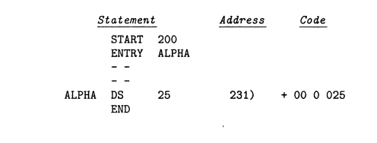
Ad

Slide 15
Absolute loader
Absolute loader doesn’t need to perform functions like linking and program relocation.
For example take assembly language example of Simplified Instructional Compute (SIC) instruction as shown in figure.
All functions are accomplished in a single pass assembler
First the header record is checked to verify that correct program has been represented for loading.
Input is read ,when the end record is encountered the loader jumps to the specified address to begin the execution of the loaded program.

Slide 16
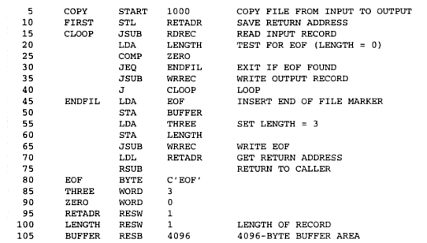

Slide 17
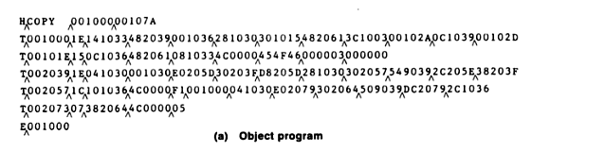

Slide 18
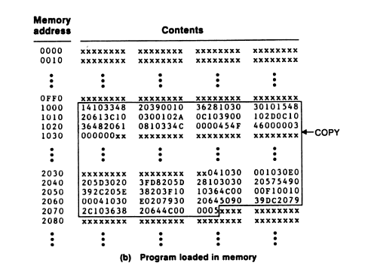

Slide 19
Bootstrap loader
Alternatively referred to as bootstrapping, bootloader, or boot program, a bootstrap loader is a program that resides in the computers EPROM, ROM, or other non-volatile memory that automatically executed by the processor when turning on the computer.
The bootstrap loader reads the hard drives boot sector to continue the process of loading the computers operating system.

Slide 20
When a computer is first turned on or restarted, a special type of absolute loader, called bootstrap loader is executed
This bootstrap loads the first program to be run by the computer -- usually an operating system

Slide 21
Binary programs
It is machine language program contains a set of program units (SP) such that for all Pi belongs to SP
i) Pi has been relocated to the memory area starting at link origin
ii) Linking has been performed for each external reference
To create binary program from object modules linker invocation is required
Linker<link origin>,<object module name>[,<execution start address>]

Slide 22
Design of linker:
Object module: It contains all information necessary to relocate and link the program. It consists of following elements:
1)Header:Contains translated origin ,size and execution start addtress of program.
2)Program:Contains the machine code corresponding to program.
3)RELOCTAB: Descibes IRR.It cntains single field:translated address.
4)LINKTAB(Symbol,Type,translated address):Contains information concerning public definitions.
Type:PD/EXT

Slide 23
Design of linker:
Object module header
T_origin | size | Exe_start_address
500 | 42 | 500
LINKTAB
RELOCTAB
Symbol | Type | Translated address
ALPHA | EXT | 518
MAX | EXT | 519
TOTAL | PD | 541
Translated Address
500
538

Slide 24
Design of linker: Relocation algorithm:
1.program_linked_origin:=<link origin>
2.For each object module
a)t_origin:=translated origin of the object module.
OM_size:=size of the object module;
b)relocation_factor:= program_linked_origin - t_orgin;
c)Read the m/c lang. prog. In work area;
d)Read RELOCTAB of the object module
e)For each entry in RELOCTAB
i)Translated_addr:=Address in theRELOCTAB entry
ii)Addr_in _work_area:=Addr_of _work_area+Translated_addr-t_orgin;
iii)Add relocation_factor to the operand address in the word with the addr. in work area.
f) program_linked_origin:= program_linked_origin+OM_size;

Slide 25
Ex: Let addr in work area=300,
Link origin=900,t_origin=500 ,size=42 then
Relocation factor=900-500=400
Addr_in _work_area=300+500-500=300
This word contains the instruction for
READ A
It is relocated by adding 400 to the operand address in it.

Slide 26
Design of linker: Linking algorithm:
1.program_linked_origin:=<link origin>
2.For each object module
a)t_origin:=translated origin of the object module.
OM_size:=size of the object module;
b)relocation_factor:= program_linked_origin - t_orgin;
c)Read the m/c lang. prog. In work area;
d)Read LINKTAB of the object module
e)For each entry in LINKTAB with type=PD
i)name:=symbol;
linked_address:=translated_address+relocation factor;
Enter(name,linked_address)in NTAB
f)Enter(object module name,Prog_linked_origin)in NTAB
g)Program_linked_origin:=Program_linked_origin+OM_size;

Slide 27
3.For each object module
a)t_origin:=translated origin of the object module
program_linked_origin:=load address from NTAB;
b)For each LINKTAB entry with type=EXT
i)Addr_in_work_area:=Addr of work area+Program_linked_origin- Link_origin+translated addr. –t_orgin;
ii)Search symbol in NTAB and copy its linked address. Add this linked address to operand address in the word with the address with address_in_work_area.

Slide 28
LINKTAB
Symbol | Type | Translated address
ALPHA | EXT | 518
MAX | EXT | 519
TOTAL | PD | 541
NTAB
Symbol | Linked address
Total | 941
P | 900
Q | 942
Alpha | 973

Slide 29
SELF
Non relocating programs
RELOCATION PROGRAMS
is a program which cannot be executed in any memory area other than area starting on its translated origin
Relocatable program : Can be processed to relocate it to a desired area of memory
Self- relocating programs
Program which can perform the relocation of its own
address sensitive instructions.
It Contains
A table of information concerning address sensitive instructions
Code to perform relocation of ASI. This is called relocating logic

Slide 30
Linking for overlays
An overlay is a part of a program which has same load origin as some other part of the program
Used to reduce memory requirements of the program
Program containing overlays is called overlay
structured program.
It consists of
1 Permanently resident portion, called root
2 Set of overlays

Slide 31
First root is loaded and given control for execution
Other overlays are loaded when its needed.
Loading new overlay overwrites old overlays coz we have same load origin for all overlays
The structure of program is designed by identifying mutually exclusive modules i.e modules do not call each other.
Should be avoided to reside simultaneously in memory.

Slide 32
Ex
Program with six section name as init, read ,prog_a,prog_b , prog_c and print.
How overlay is done for this program..?

